Slide 1
The Atari Paper
Playing Atari with Deep Reinforcement Learning (2013)
Authors
Volodymyr Mnih Koray Kavukcuoglu David Silver
Alex Graves Ioannis Antonoglou Daan Wierstra Martin Riedmiller
Presented by
Alex Chilton
Yell Leuteneggger
Rolf Moser
Alexander Pilipenko
December 13, 2024

Slide 2
Agenda
What is Atari?
Introduction
The Greeks
Model Architecture
Experiments
Conclusion

Slide 3
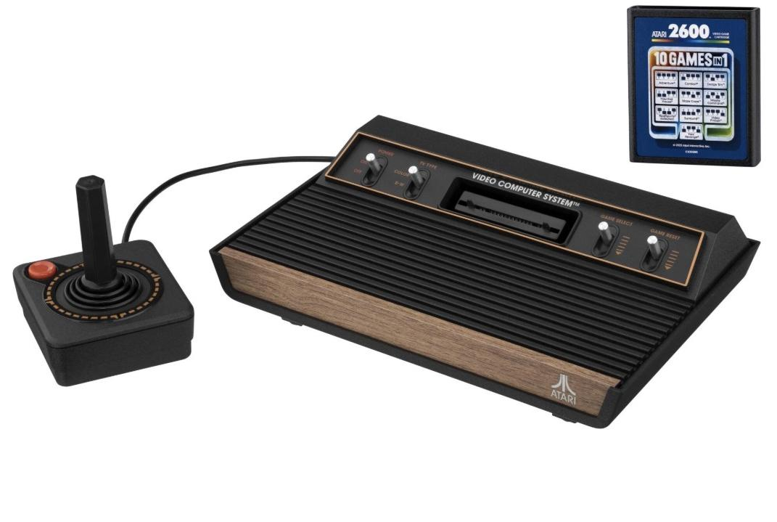
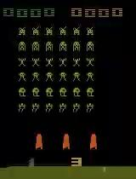
What is Atari?
Atari Console 2600
Hugging Face Models

Slide 4
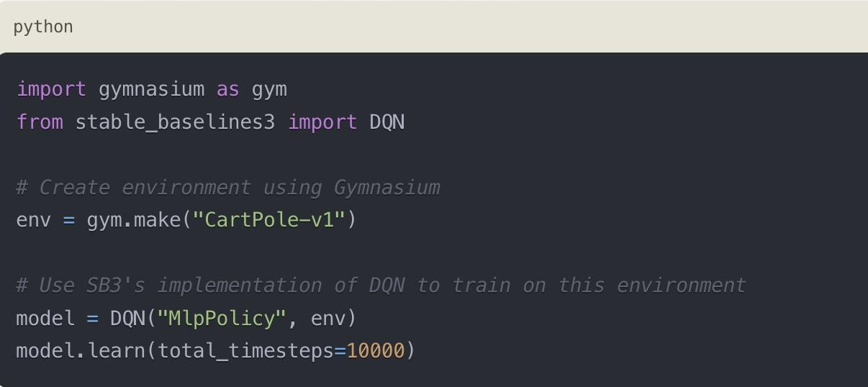
What is OpenAi Gym?
Gym was the original environment framework created by OpenAI
Gymnasium is a community-maintained fork of Gym after OpenAI stopped maintaining it
Stable-Baselines3 library of reinforcement learning algorithms that works with Gym/Gymnasium environments

Slide 5
Introduction
What is this paper about?
First DL model to learn control policies from high-dimensional sensory input using reinforcement learning (RL)
Convolutional NN trained with Q-learning
Method applied to seven Atari 2600 game
Outperforms previous approaches and human expert on some of the games
Definition: Reinforcement learning
RL is a branch of ML in which an (intelligent) agent learns how to take actions and make decisions by acting in/interacting with an environment to maximize some cumulative reward.
Learning through interactions with the environment
Getting feedback in form of reward or penalty to improve the decision-making strategy over time

Slide 6
Introduction
Okay, let’s start!
Challenge of RL: → Learning to control agents from high-dimensional sensory inputs
What we have so far with RL: → Manually engineered features → Systems relying on the quality of the feature representation
Innovation in DL: Extraction of high-level features from raw sensory data → Use of various NN architectures
Can this be used when working with RL and sensory data? → But are there for sure some challenges!

Slide 7
Introduction
What are the challenges?
DL: Large hand-labeled training data
What about RL? 1. Learn from scaler reward signal (noise, sparse and delayed) → Delay between action/reward (vs. direct input/targets in supervised learning) 2. Sequence of correlated states (vs. independence of data samples) 3. Non-stationarity of the data distribution (vs. assumption of fixed underlying distribution in DL)

Slide 8
Introduction
How do they approach this?
Convolutional NN → Learn control policies from a raw video data in complex environment
Trained using a variant of the Q-learning algorithm → Stochastic gradient descent updating the weights
Experience replay mechanism → Address the problem of non-stationary distribution and correlated data → Random sampling to smooth training distribution over past behaviors

Slide 9
Introduction
How do they do this?
Application on the Atari 2600 games → Agents with high-dimensional visual inputs → Various tasks that are meant to be tricky for humans
Neural network player that learns to play these games as good as possible → Learning mimics human situation → Video input, reward signal, terminal signal and set of possible actions → Architecture and hyperparameters are kept constant across all games

Slide 10
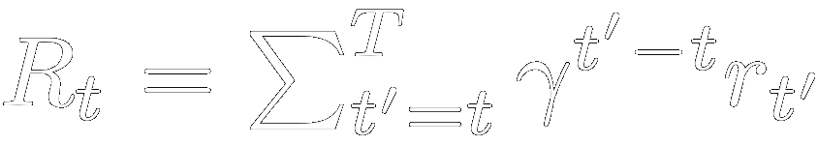
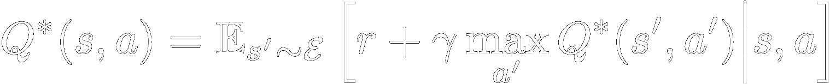
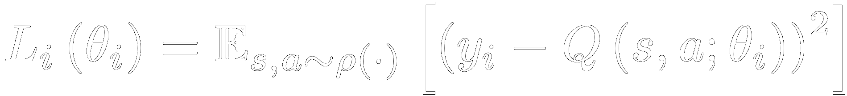
The Greeks

Slide 11
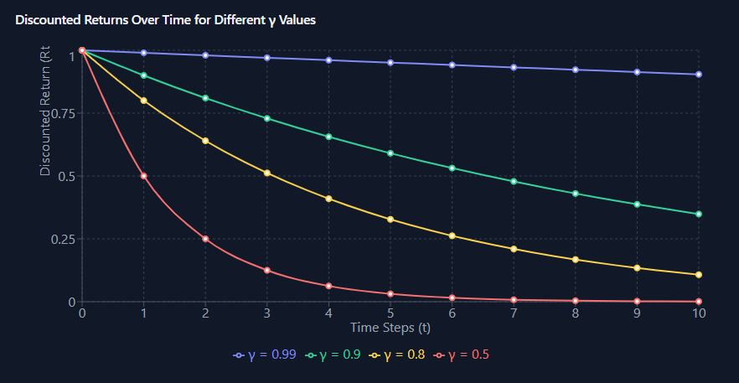
Reward Function
reward R at time t
sum of all rewards r from now (t’ = t) to the end of the game (t’=T)
discount factor 𝛾 times future r
future rewards get discounted more

Slide 12
Q Function
Q* is the optimal Q-function in state s taking action a
𝝅 is the policy
with the highest rewards
𝔼[Rt]
expected sum of rewards
given
current state s_{t} is s,
the current action a_{t} is a
and we
apply policy 𝝅

Slide 13
Bellman Equation
expected value over next state s’
as a function of the environment
ε, the emulator
maximum Q-value over all possible actions a’ in the next state s′
no need for policy 𝝅 since the optimal policy is just selecting the action with highest Q-value
this is recursive
Q* = r₁ + 𝛾Q₁
Q₁ = r₂ + 𝛾Q₂
Q₂ = r₃ + 𝛾Q₃
Q₃ = ….

Slide 14
Loss
Loss with the current weights
s and a are sampled according to some distribution ρ
y_{i} is the target reward,
use known r + Q from previous model weights to compute y_{i}
using our own Q function with current weights to get
MSE loss

Slide 15



Understanding Q-Learning through Atari
Core Principle of Q-Learning
Q-Learning is a model-free reinforcement learning algorithm that estimates the optimal action-selection policy by learning the Q-values of state-action pairs.
Application in Atari Games
Deep Q-Learning, using a neural network, enabled agents to achieve human-level performance in Atari games by optimizing rewards through state-action learning.
Deep Q-Network (DQN) Integration
The integration of Q-Learning with deep neural networks allowed for generalization across high-dimensional state spaces, making it scalable for complex tasks.

Slide 16
Experiments
Experiments performed on 7 Atari games → Beam Rider, Breakout, Enduro, Pong, Q*bert, Seaquest and Space invaders
No game-specific information → Same architecture, learning algorithm and hyperparameters
One change made to the reward structure of the game during training → Different scales for the scores between games → Normalization
[-1, 1]: Positive rewards: 1 ; Negative rewards: -1
Drawback (potentially): Agent does not capture the magnitude

Slide 17
Experiments
RMSProp algorithm → Good for noisy and non-stationary updates
ε-greedy strategy annealed linearly from 1 to 0.1 at the beginning and then fixed at 0.1 → With Prob ε: Exploration (Trying new actions to discover the associated rewards) → With Prob (1-ε): Exploitation (Leveraging known actions to maximize the cumulative reward) → ε captures the trade-off between exploration and exploitation.
Thus: At the beginning a lot of exploration, then later focus on exploitation
Training for 10 mio of frames (frame = single step in the environment)
Replay memory of 1 mio frames → Training on recent and relevant data → Storage of recent state-action-rewards-next state

Slide 18
Experiments
Frame skipping-technique → Agent does not process all the frames → Example: k=4 → Frames 1, 2, 3 and 4:
Frame 1: agent observes the state and chooses “go left”
Skip frames 2, 3, 4 → Environment is still updated as if agent continued with “go left”
Frame 5: agent observes updated state and chooses “jump up”
This technique allows to play k times more and is more computation friendly
Usually k=4 (except for Space invaders with k=3)

Slide 19
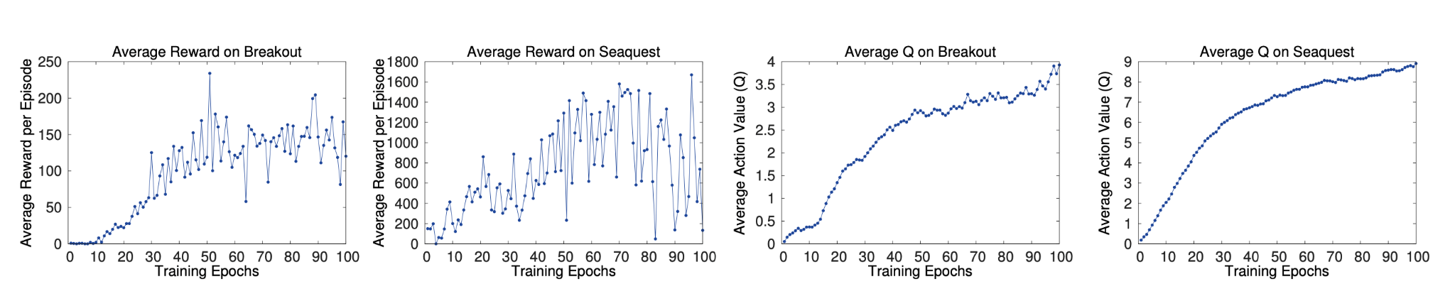
Experiments
Training and stability
Supervised learning: Performance evaluation via training and validation sets
This is challenging with RL → Use other metrics → 1. Total reward the agent collects in an episode or game averaged over games (A) (Noisy bc small changes in weights affect distribution greatly) → 2. Action-value fct Q: Discounted reward by following policy in a certain state (B)
A
B

Slide 20
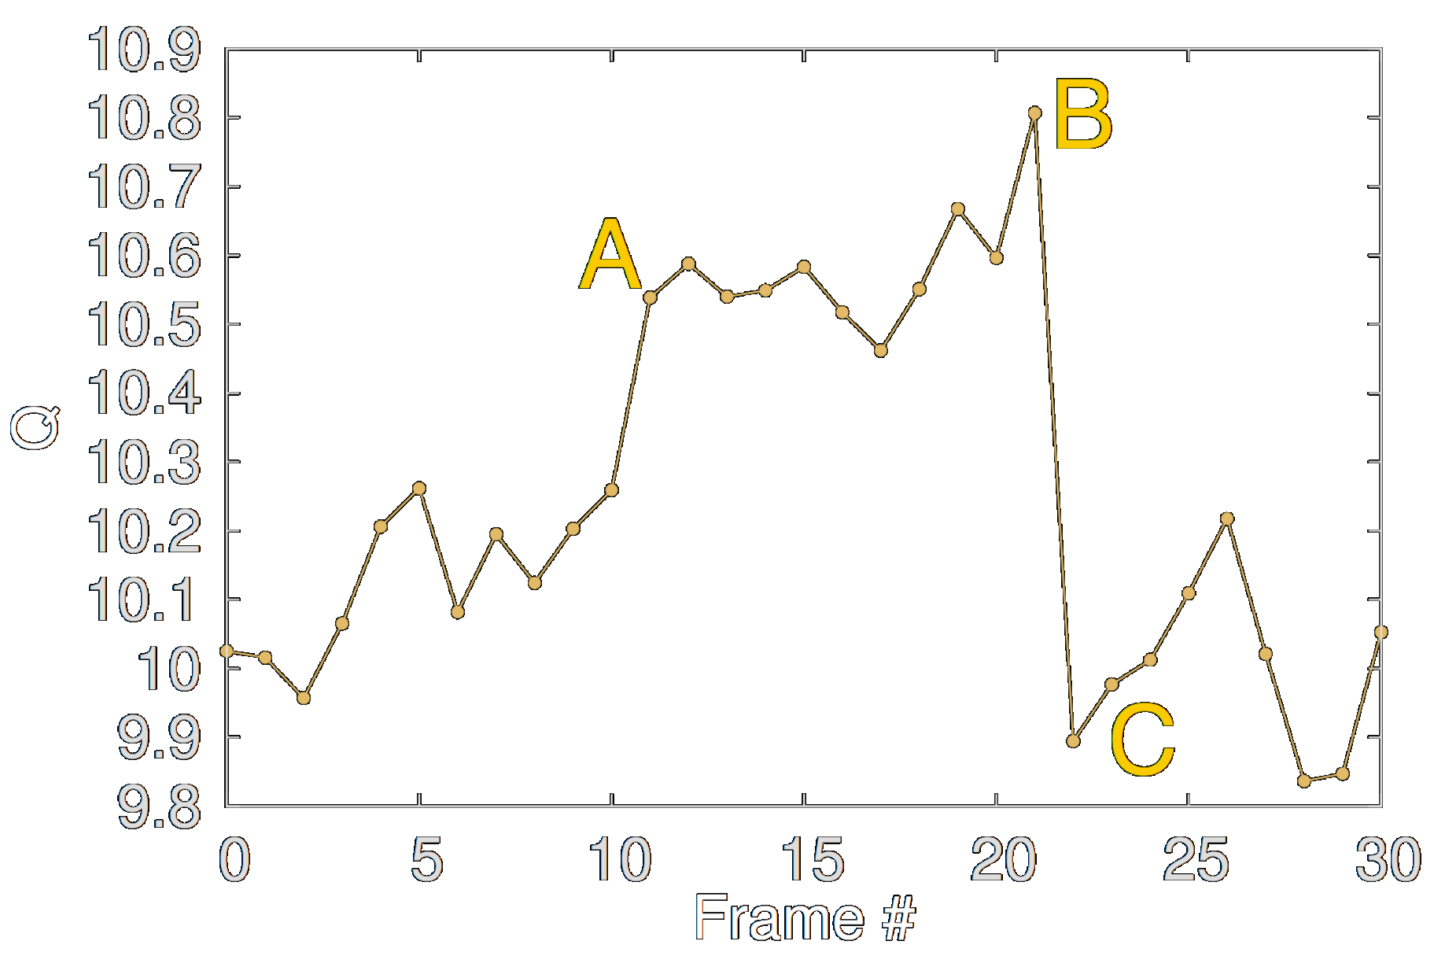
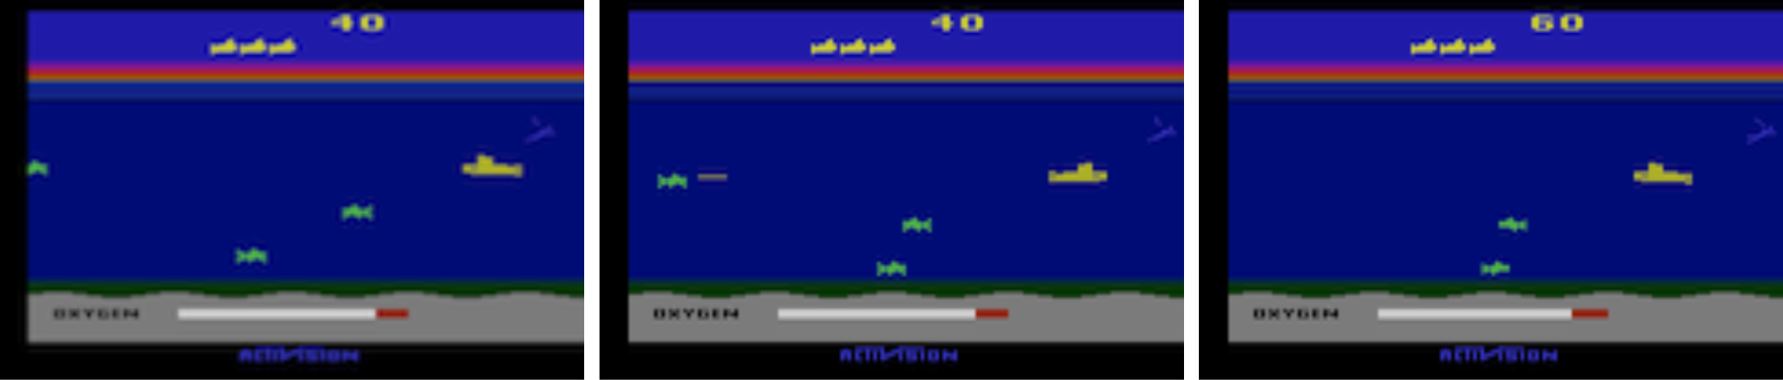
Experiments
Value function
A: Enemy pops up on the left → Value jumps up
B: Agent fires a torpedo → Value peak
C: Enemy is killed → Value falls down
→ Model learns how the value fct behaves
Seaquest
A
B
C

Slide 21
Experiments
Main evaluation
Comparison of the results with best performing method from the literature → Sarsa: Update of action-value function based on the current policy (learns on state, action, reward, next state, and next action) → Contingency: Sarsa + learned representation of segments of the screen → Human → Random: Selection of the actions uniformly at random → Deep Q Network (DQN): The approach proposed by the paper (ε-greedy)

Slide 22
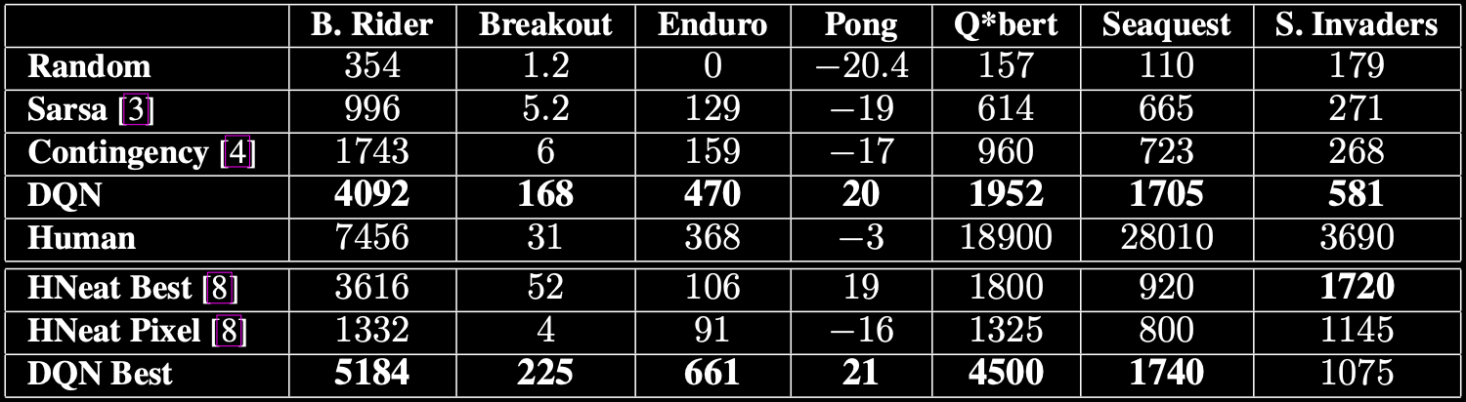
Experiments
Main evaluation
Comparison of the results with best performing method from the literature → Sarsa: Update of action-value function based on the current policy (learns on state, action, reward, next state, and next action) → Contingency: Sarsa + learned representation of segments of the screen → Human → Random: Selection of the actions uniformly at random → DNQ: The approach proposed by the paper

Slide 23
Experiments
Main evaluation
Comparison to the evolutionary policy search approach → Evolutionary algorithms like mutation and selection to find policies
HNeat Best → Result when using a hand-engineered object detector algorithm → Object and location
HNeat Pixel → Object representation given by 8 colors and build into a sequence
New method outperforms the other methods, and sometimes also the human.

Slide 24
Conclusion
So what did we see today?
New general DL model for RL
Master complex control policies for Atari 2600 using raw pixels
Version of Q-learning
Outperforms other methods (a human) in 6/7 (3/7) cases

